Slide 1

END-TO-END PIPELINE
Crowd Density Prediction & Optimization
Data Integration • Feature Engineering • ML Tuning • Power BI
1.4398
0.9989
Final RMSE
Final R²

Slide 2






01 • PROBLEM STATEMENT
The Crowd Management Challenge
Unpredictable Flow
Manual Limits
Strategic Objective
Severe crowd surges and dynamic congestion hotspots.
Impossible to continuously monitor all seating zones.
Optimize security allocation and flow management.
Target Variable: Predict continuous People_Count via supervised regression.

Slide 3

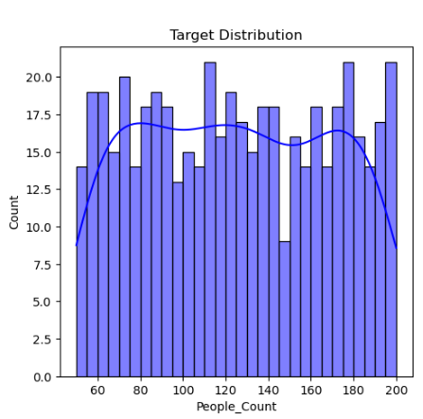
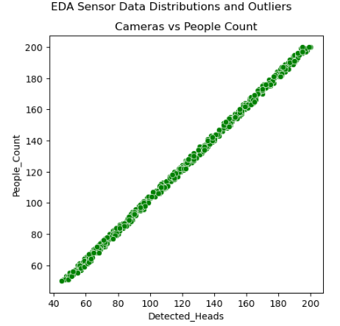
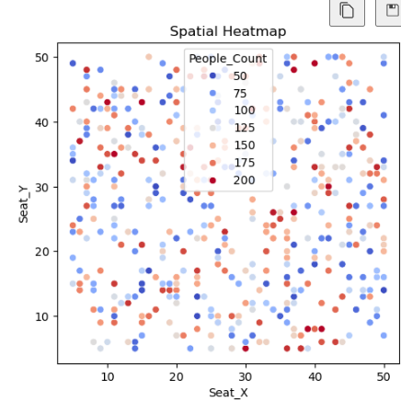
02 • EXPLORATORY ANALYSIS
Sensor Data & Spatial Mapping
Target Distribution
Even frequency spread across historical data.
Clear Predictors
Perfect linear alignment with detected heads.

Slide 4

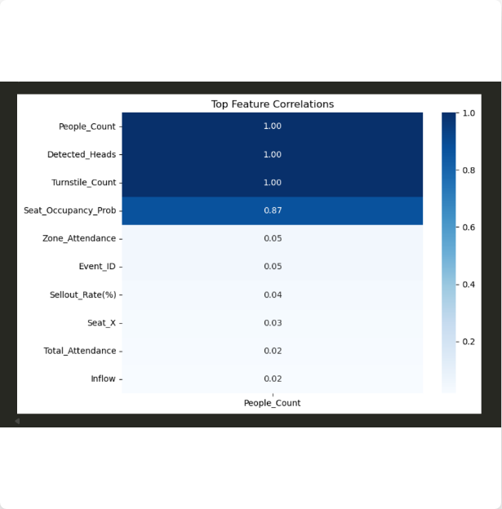

03 • VARIABLE RELATIONSHIPS
Near-Perfect Predictors
r = 1.00
Detected_Heads and Turnstile_Count strictly mirror People_Count.
Research Note
Extremely strong correlations explain linear baseline success.

Slide 5




04 • FEATURE SELECTION
Retained vs. Rejected Inputs
11 Retained Features
Rejected Variables
Turnstile Count & BLE Pings
Event_ID & Seat_ID Excluded to prevent data leakage and event overfitting.
Pressure Mat Activations
Detected Heads & Visibility
Raw Flow Edges Aggregated into numerical inflow/outflow instead.
Spatial (Seat X, Y)
Attendance Metrics
Categorical Strings Dropped for strict numerical-only scaling pipeline.
Aggregated Inflow & Outflow

Slide 6





05 • PREPROCESSING
Data Pipeline Architecture
80/20 Split
StandardScaler
Target Variable
Strict separation of training and generalization test data.
Converts varying numerical scales into standard z-scores.
People_Count

Slide 7
06 • MODEL SELECTION
Algorithm Performance
Model | RMSE | R² Score | Observation
Linear Regression | 1.4404 | 0.9989 | Best baseline performance.
Gradient Boosting | 1.7437 | 0.9984 | Strong generalization.
XGBoost | 1.7506 | 0.9984 | Strong generalization.
Random Forest | 1.8749 | 0.9981 | Adequate non-linear fit.
Decision Tree | 2.7350 | 0.9960 | Highest prediction error.

Slide 8


07 • FINAL OPTIMIZATION
UNSEEN TEST RESULTS
Ridge Regression Tuning
1.44
GridSearchCV + 5-fold cross-validation applied to control coefficient magnitude among highly correlated predictors.
Root Mean Squared Error
99.9%
α = 0.01
Optimal L2 penalty selected.
Explained Variance (R²)

Slide 9

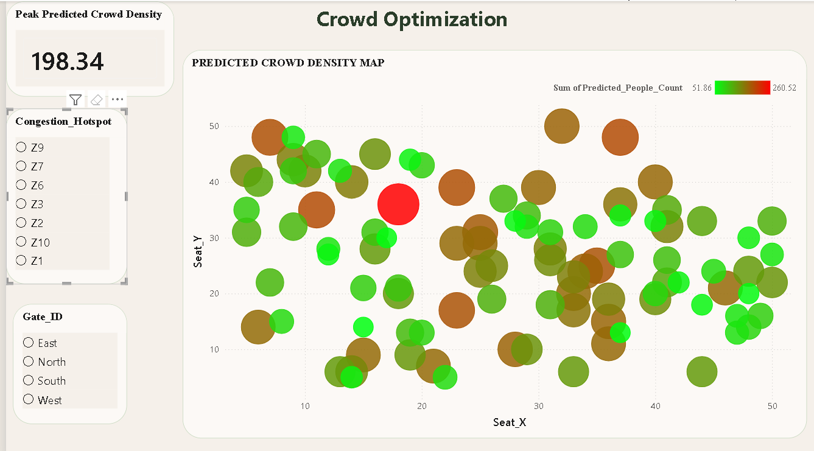
08 • DEPLOYMENT
Business Intelligence
Interactive Prediction Map
Visualizes live crowd density estimates by exact seating zone.
Hotspot Identification
Dynamic filtering by gate and congestion zone.

Slide 10






09 • CONCLUSION
Pipeline Delivered
Engineered
Optimized
Deployed
11 unified spatial, sensor, and movement features.
Ridge regression tuned for highly correlated predictors.
Interactive Power BI spatial congestion tracking.

